Slide 1

Student Performance and Failure Analysis
BY
Ahmad Khalil Ghamai
12.07.2025

Slide 2
Goal: To analyze student performance across subjects and identify factors influencing academic success and failure.
Key Questions:
What affects student grades?
Who is at risk of failing?
How do family, lifestyle, and academic behavior contribute?

Slide 3
Data Overview
Source: Combined dataset from Math and Portuguese subjects Total Records: 383 students
Key Columns:
Grades (G1, G2, G3)
G3_Avg
Study time
Alcohol use
Parental education & jobs
Absences
Support programs

Slide 4
01.
DATA COLLECTION-KAGGLE
02.
DATA CLEANING WRANGLING-PYTHON
03.
DATA QUERY AND ANALYSIS-MYSQL
DATA VISUALISATION-TABLEAU
04.

Slide 5
Analysis and Data insights
Dashboard

Slide 6
Conclusion
Summarize:
Higher study time and consistent attendance were linked to higher pass rate.
Single parents students performed well comparing to the mixed or non-parents guardians
Alcohol use, low parental education, and lack of support programs were common among students at risk of failing
Students with parents jobs as Educator or Healthcare performed better comparing to the Homemaker and Public service jobs.
Risk profiling allowed us to identify specific groups of students who may benefit from early interventions.(54-students)
Students have performed better in Portuguese comparing to Math (avg_grade: 12.51 vs 10.35).

Slide 7
Recommendations
Based on Insights:
Encourage consistent daily study (26% failure rate)
Monitor and reduce absenteeism (30 %)
Engage and support families with lower education backgrounds (22% failure rate)
Develop alcohol awareness programs (11%)

Slide 8
THANK YOU

Slide 9
Appendix

Slide 10
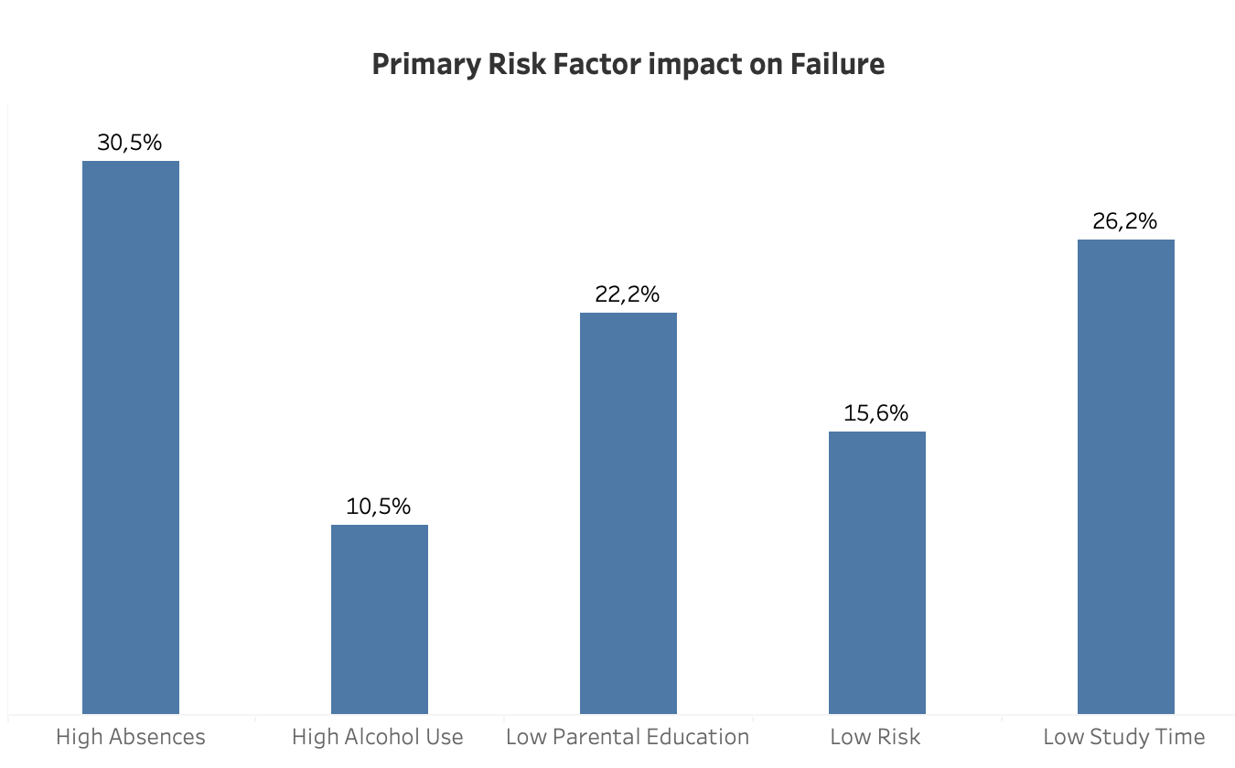
Failure Risk Profile

Slide 11
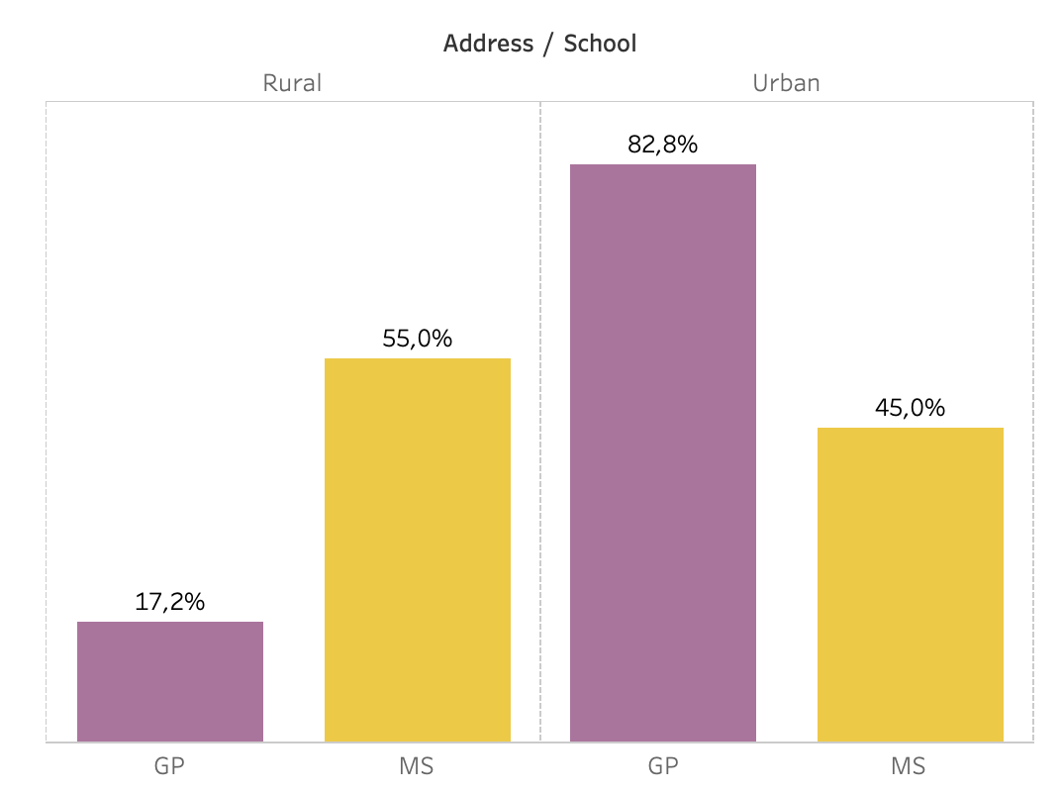
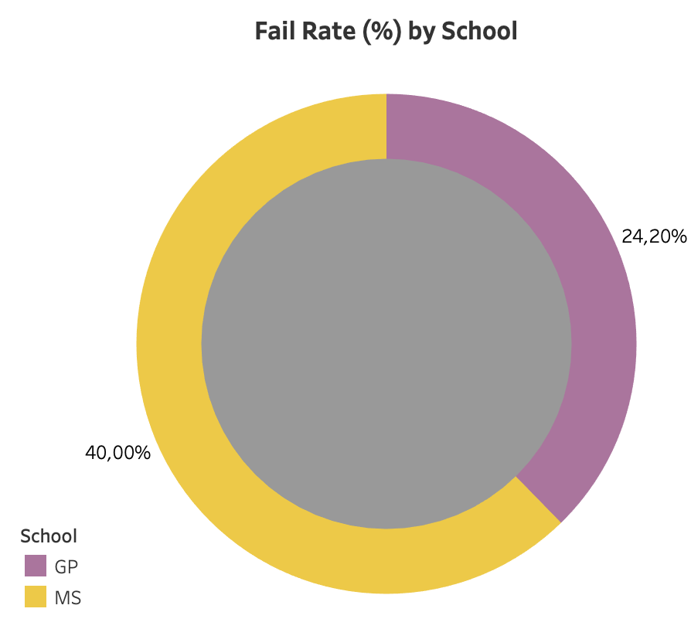
School Comparison

Slide 12
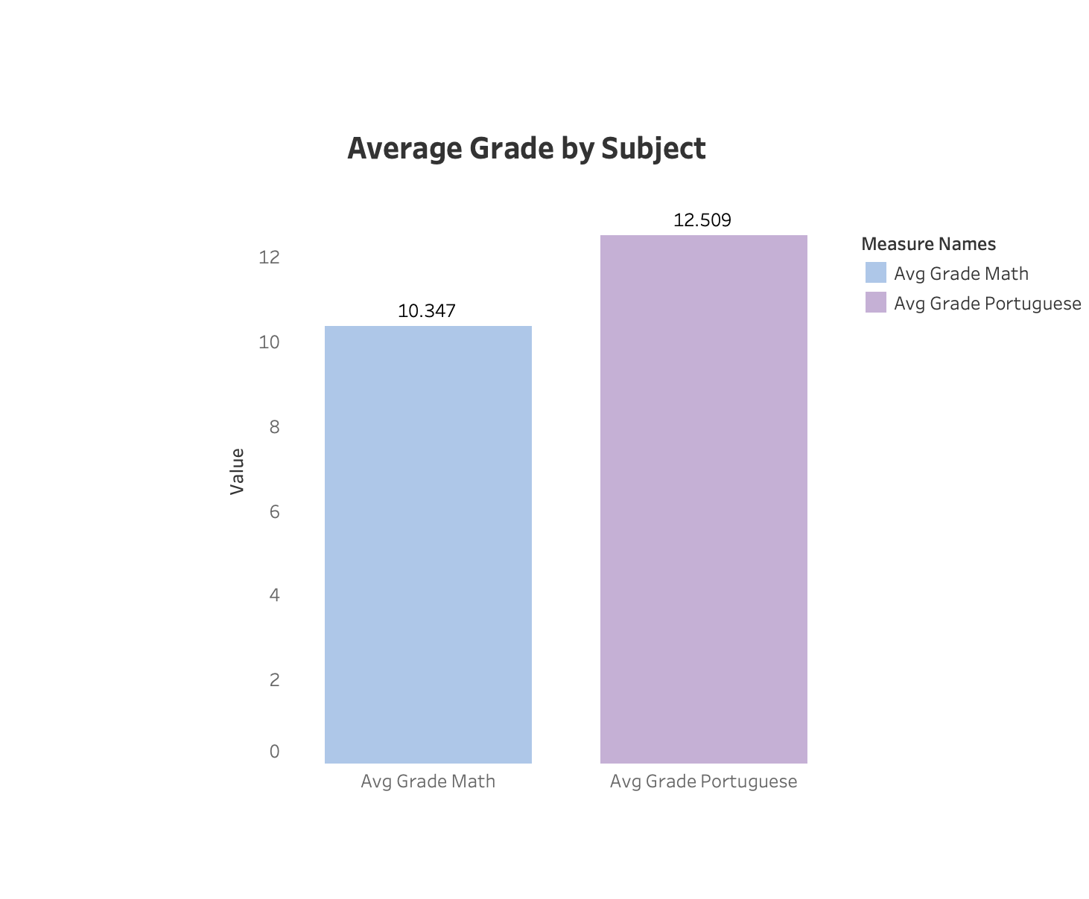
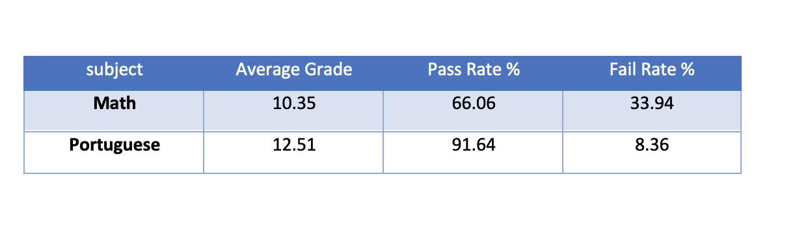
Overall Performance Summary: Subject-Level Analysis

Slide 13
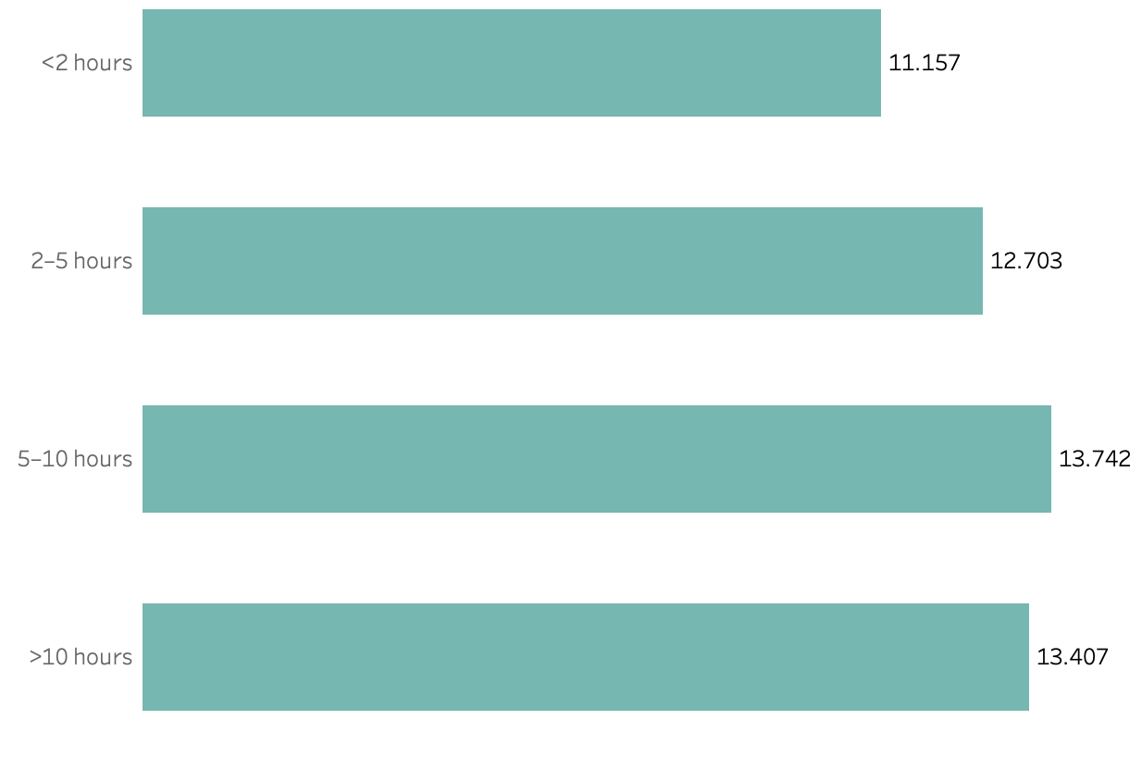
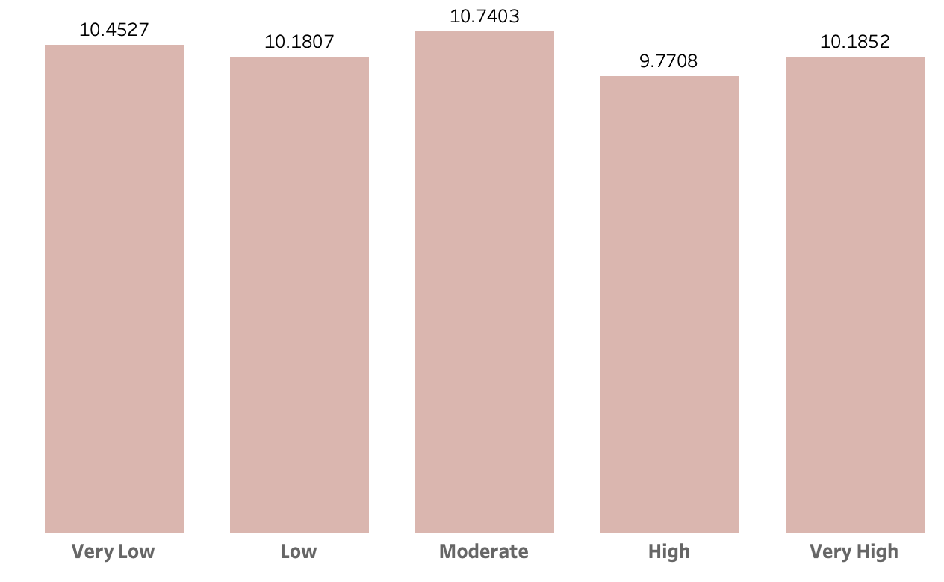
Influencing Factors: 1. Study Time vs Alcohol use
Does more study time improve grades? Daily + weekly Alcohol consumption impact

Slide 14
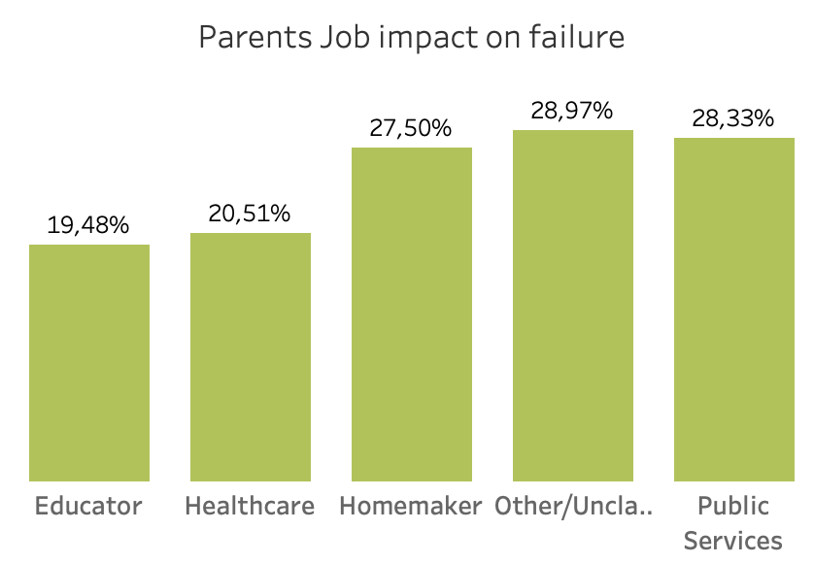
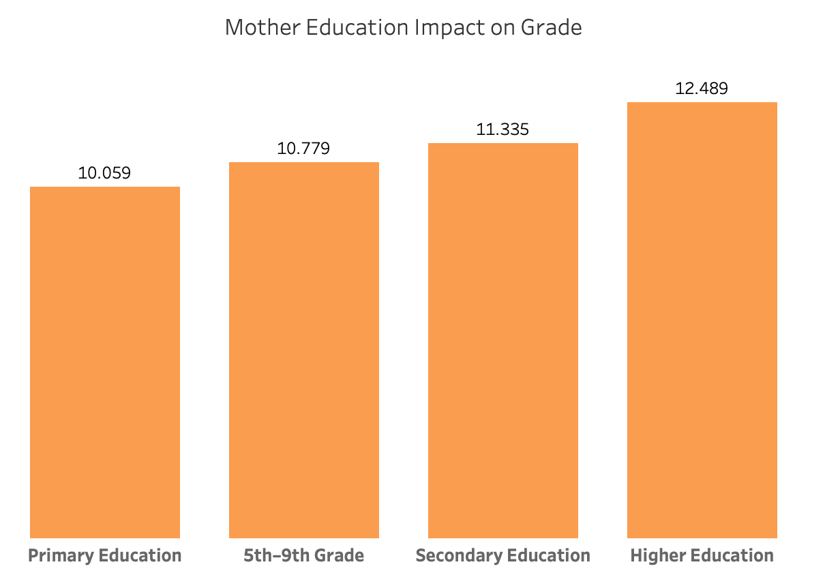
2. Parental Education vs Parental Job

